Slide 1

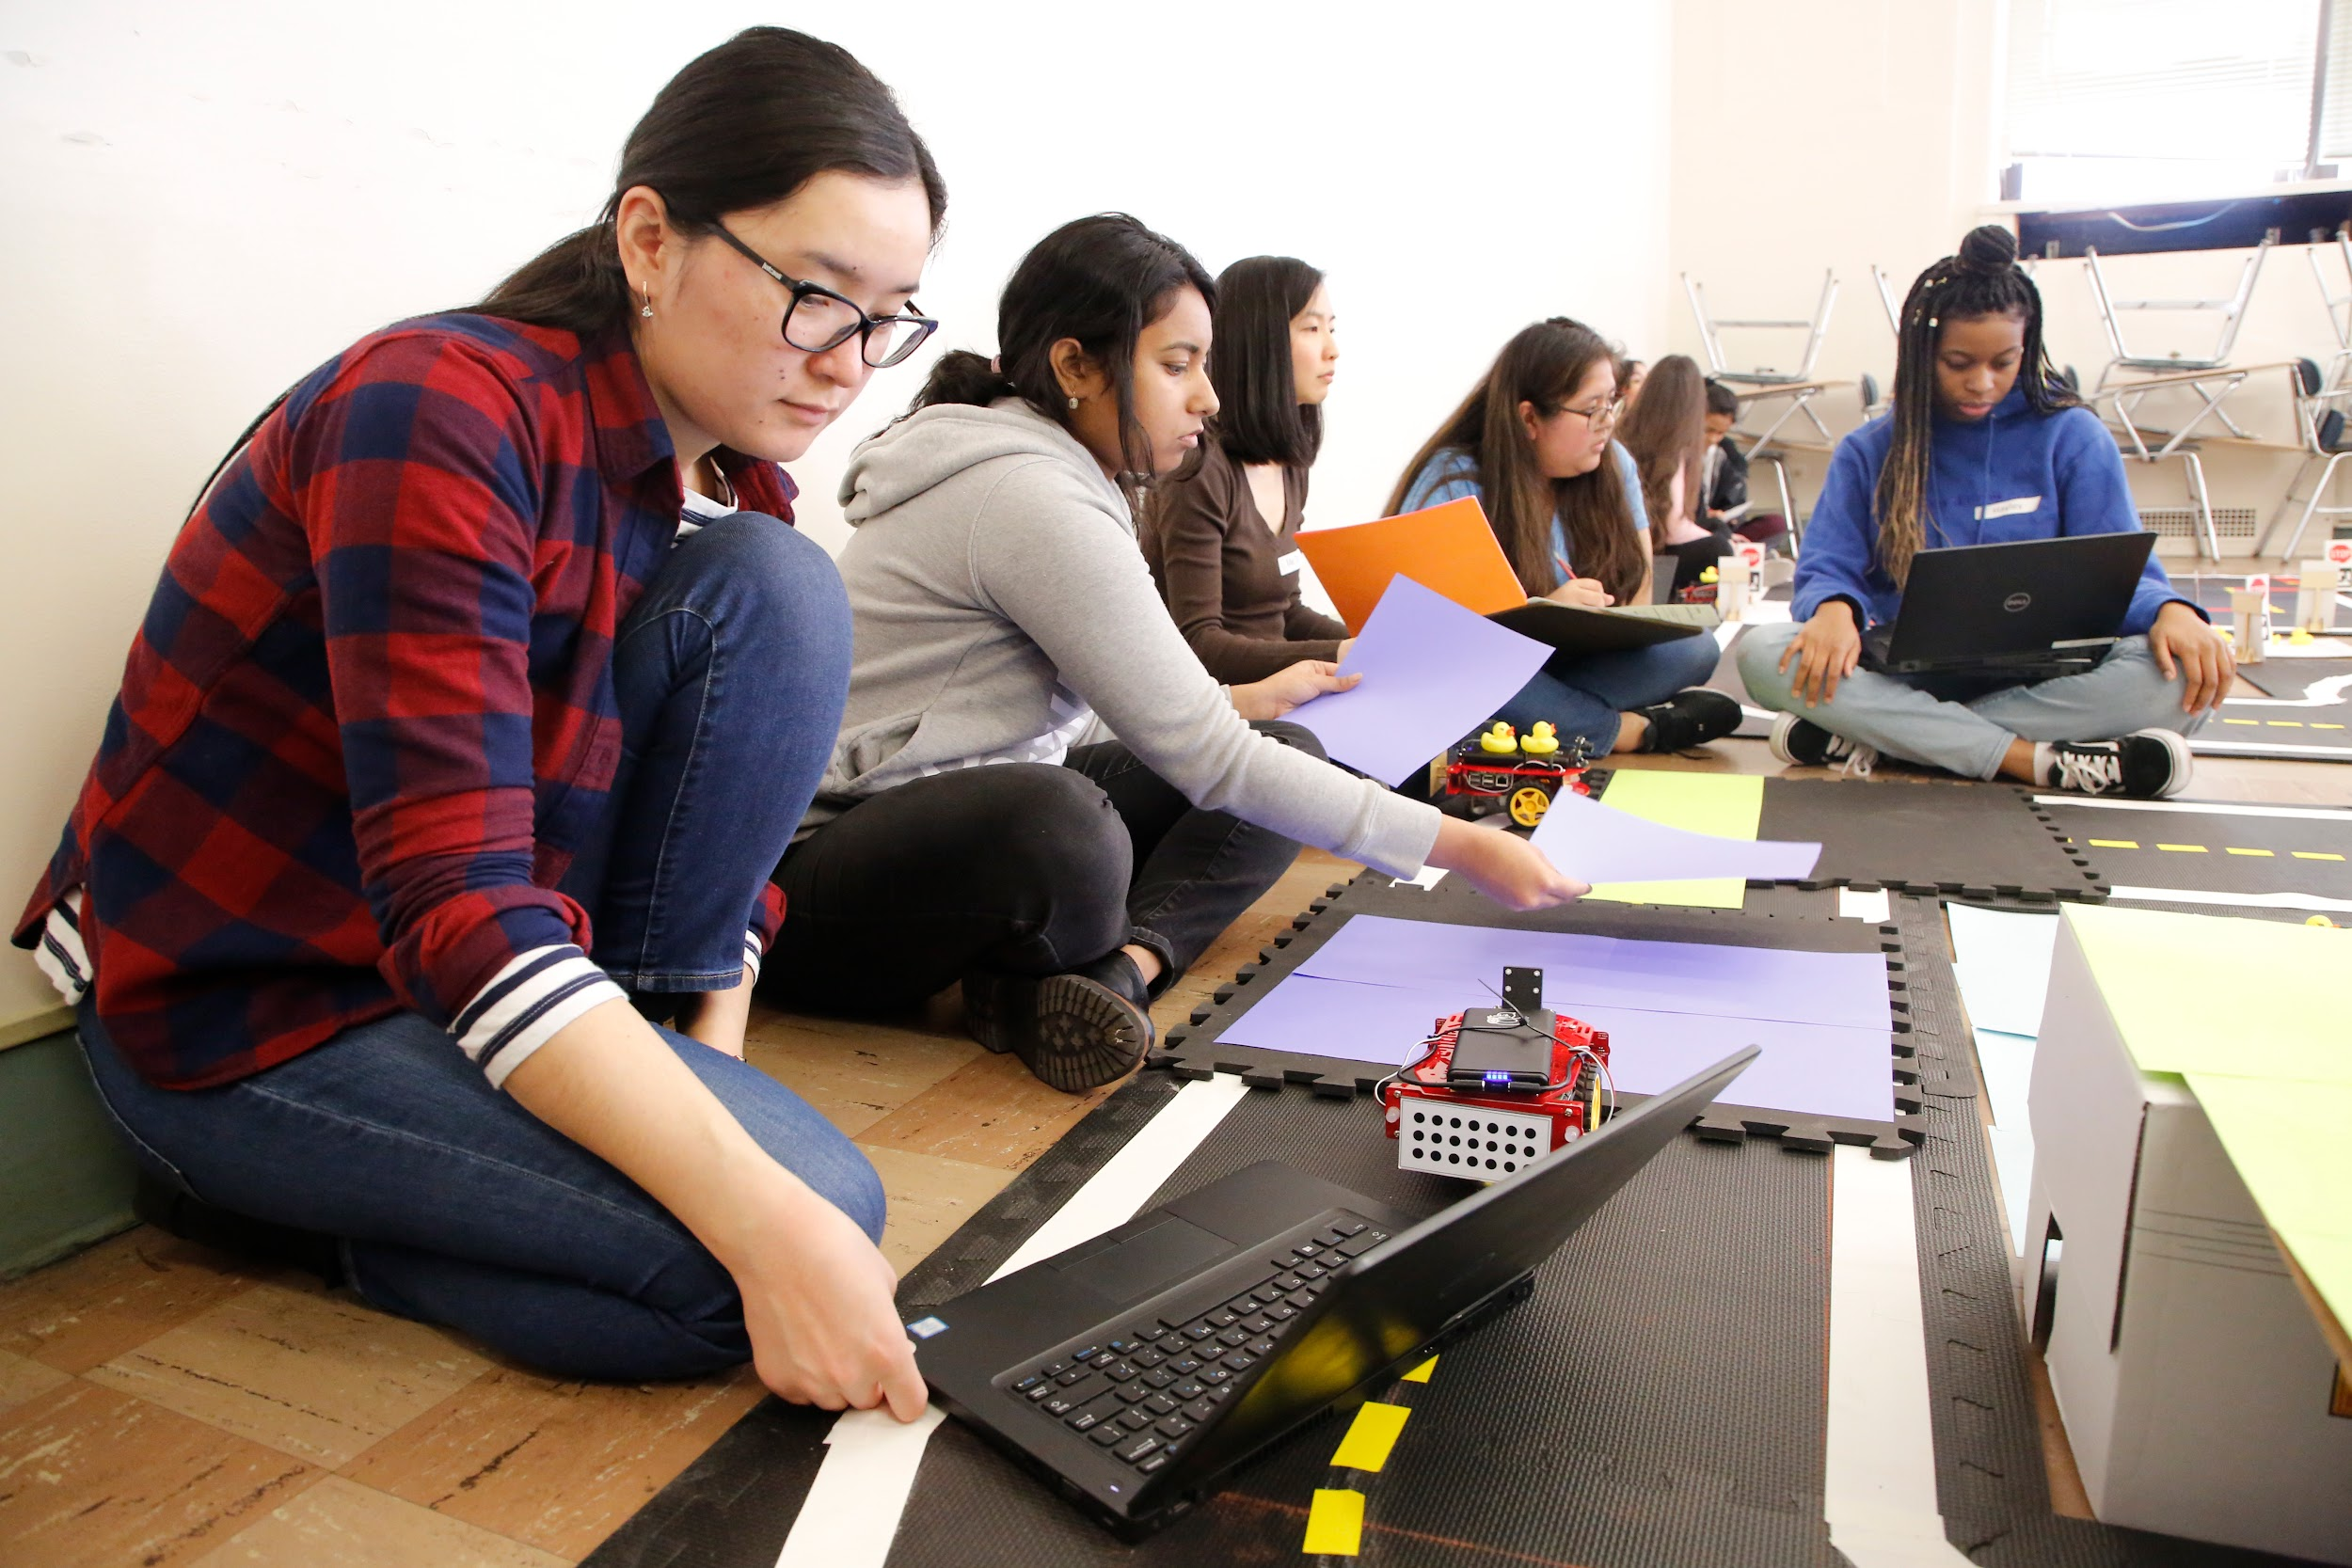



What is exploreCSR?
#exploreCSR
Increasing student pursuit of computing research is a top priority at Google, especially for students historically marginalized in the field.
Through exploreCSR, we...
FUND
colleges and universities who...
HOST
computing research workshops in order to...
SUSTAIN
students in CS graduate studies and research careers

Slide 2
exploreCSR objectives
Confidence
Self-efficacy to understand, contribute and succeed in computing research
Community
Sense of belonging among peers, mentors and faculty in computing research
Skills
Actionable knowledge to conduct, publish, present and pursue computing research professionally
Motivation
Intention to pursue graduate school and research careers in computing

Slide 3
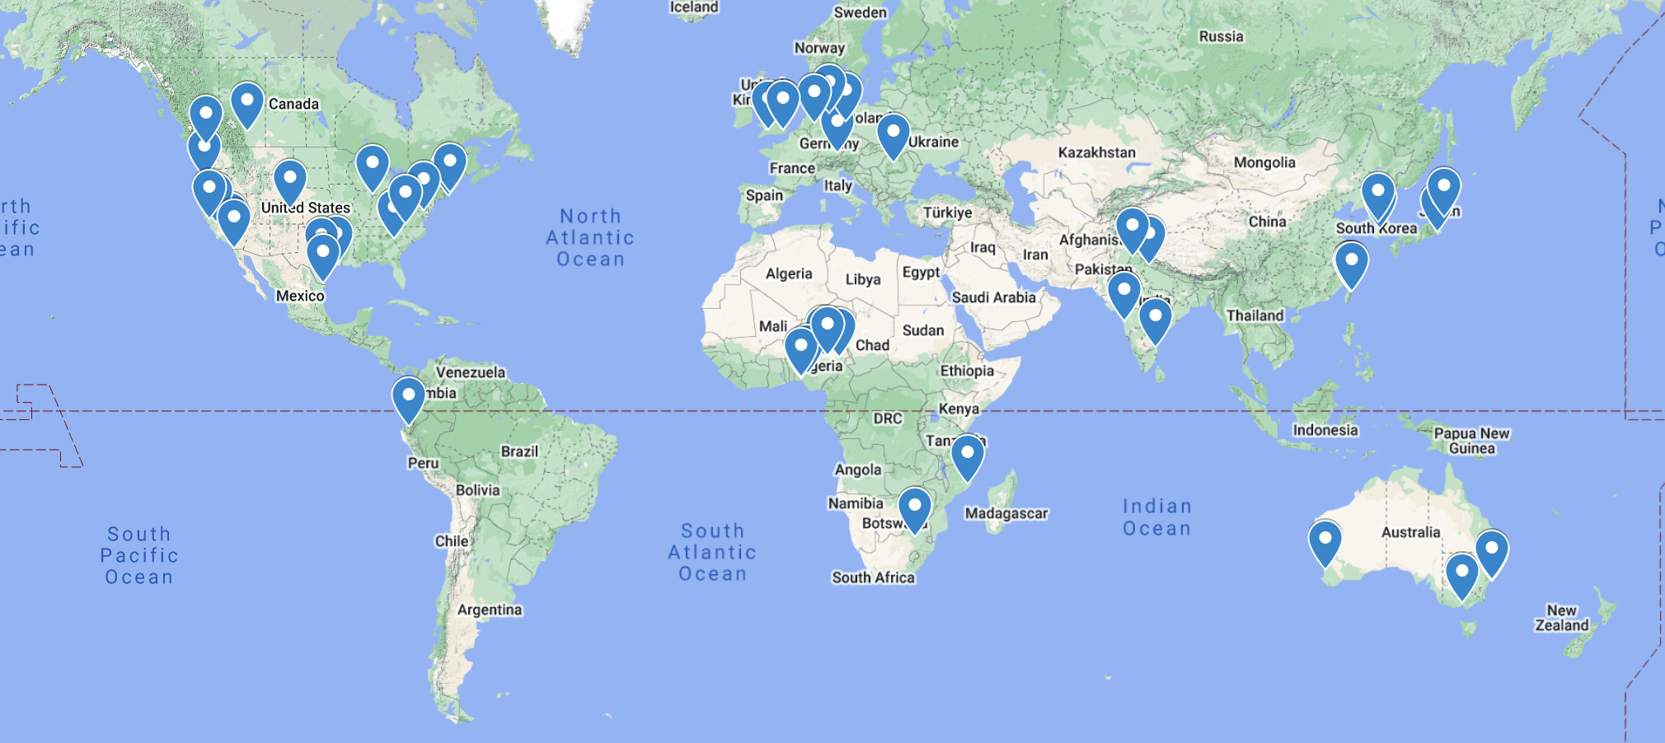
44 institutions (globally) leading the way to engage 3,700+ students in computing research
(not to scale!)
Notes:
Map available here

Slide 4
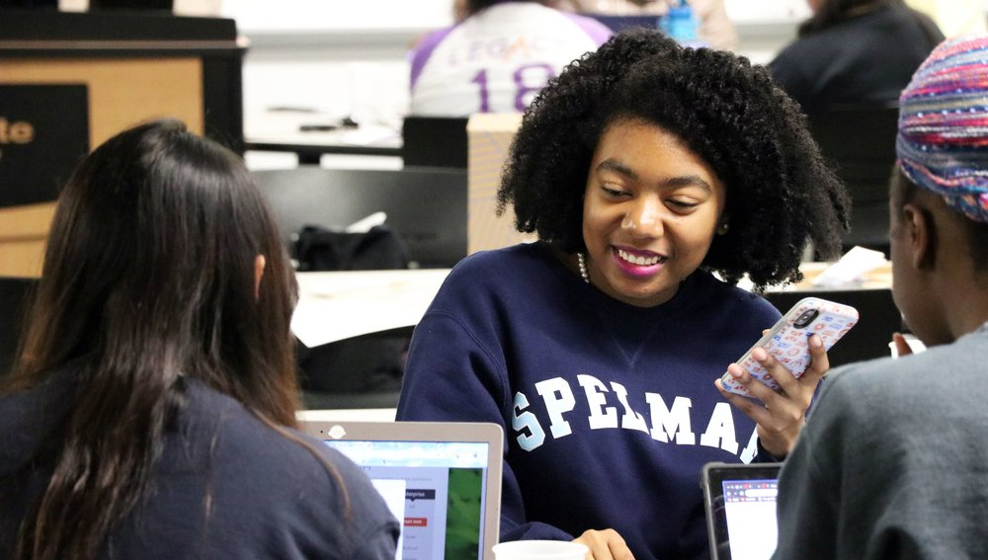
“
Research isn't some far off career; students at both the graduate and undergraduate levels are integral to the day to day functioning of almost every lab or initiative.
”
Princess Sampson
Spelman College '22
Princess and peers collaborate on a CS research project at the 2018 Georgia Tech exploreCSR workshop.

Slide 5
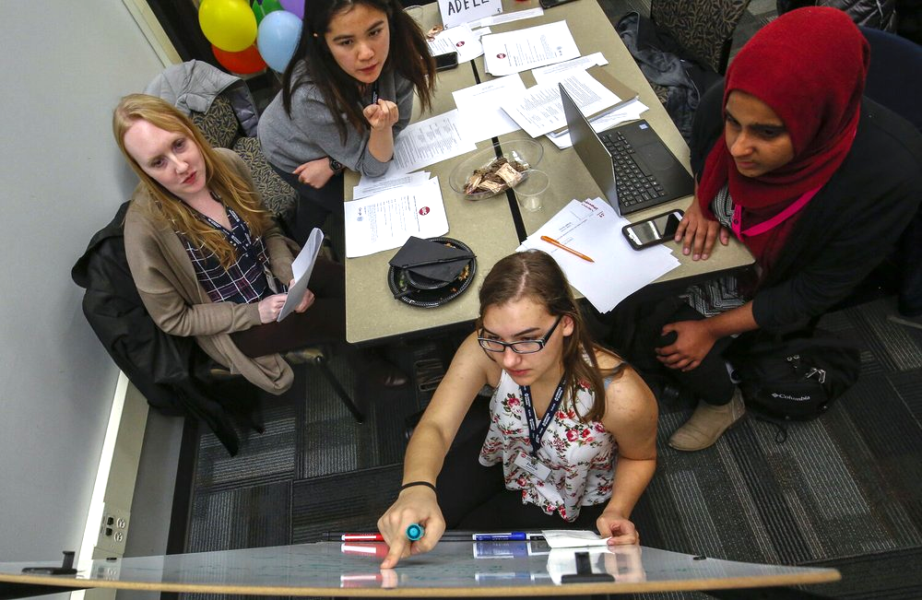
“
Attending the workshop... made applying to grad school a lot less daunting, and more importantly, a much more tangible path to pursue.
”
Nimeesha Chan
University of Illinois at Chicago ‘21
Nimeesha, second from left, and peers collaborate on a CS research project at the 2019 UIC exploreCSR workshop.

Slide 6
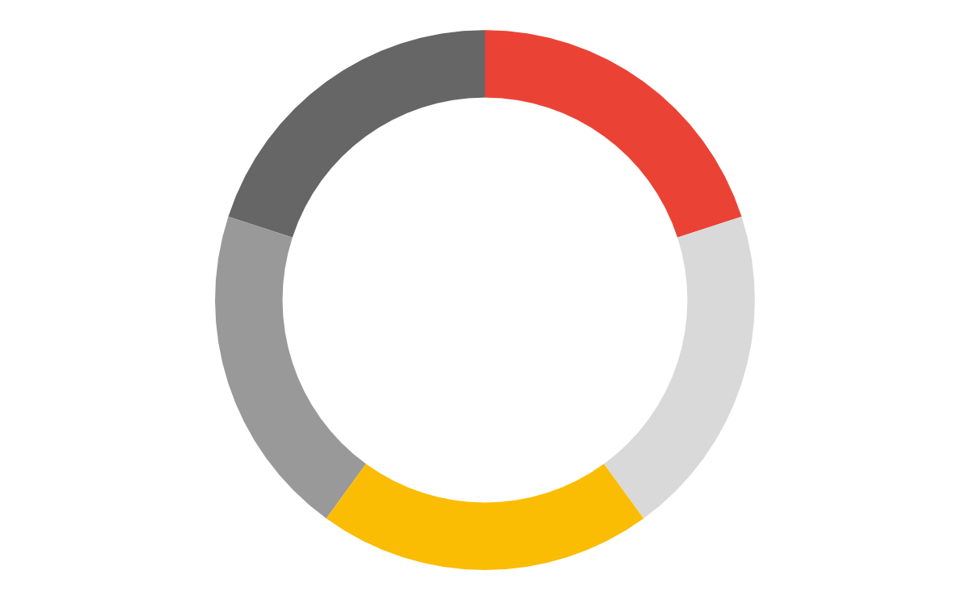

exploreCSR surveys
Google is excited to support students like you in computing research, but we need your help to maximize the impact!
Planning
Pre-survey
exploreCSR cycle
Improving
Ensure your voice and experiences are heard to improve the program and CS education - complete both the pre and post surveys!
Workshop
Post-survey

Slide 7
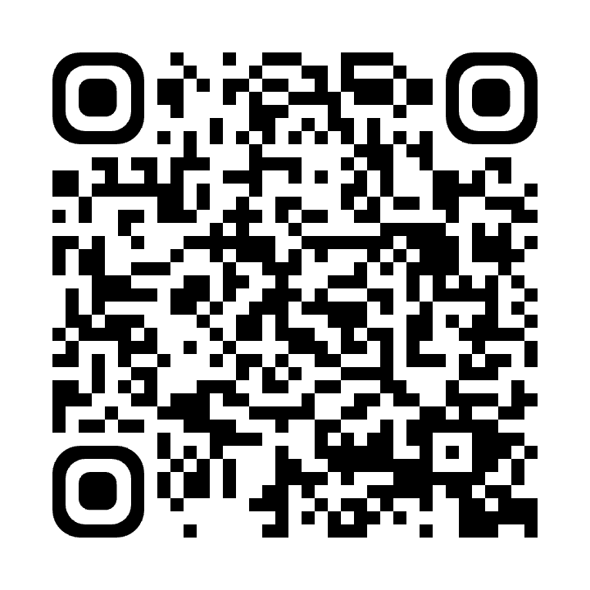

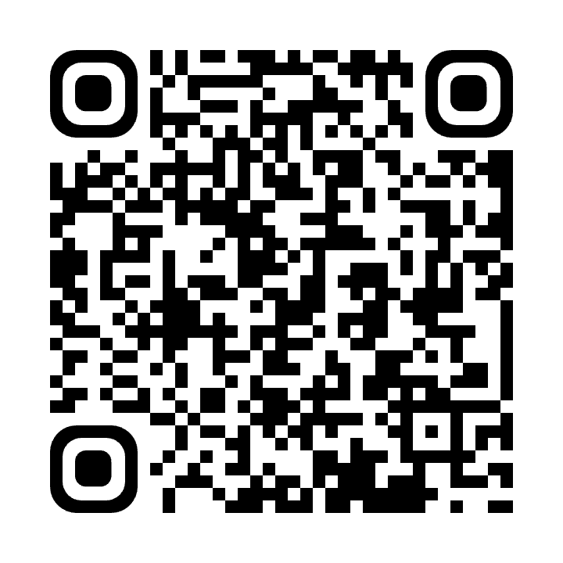

Stay connected!
#
Tag your photos with #exploreCSR for a chance to be featured in future blogs, announcements, and more!
pre-survey
Visit careers.google.com/students to learn about internship opportunities and other professional resources
Visit research.google/outreach to learn more about Google’s collaborations with the research and academic communities
post-survey
Follow us on Twitter @googleai & @googlestudents

